Slide 1
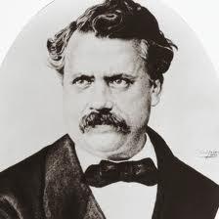
Louis Vuitton 1821-1892
By: Katie Nolan

Slide 2
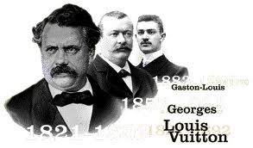
Louis Vuitton

Slide 3
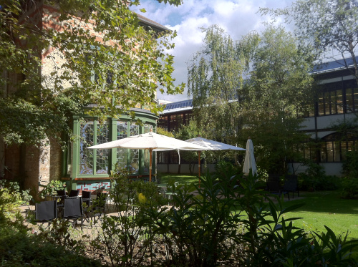
Outside of the Vuitton Family Home

Slide 4
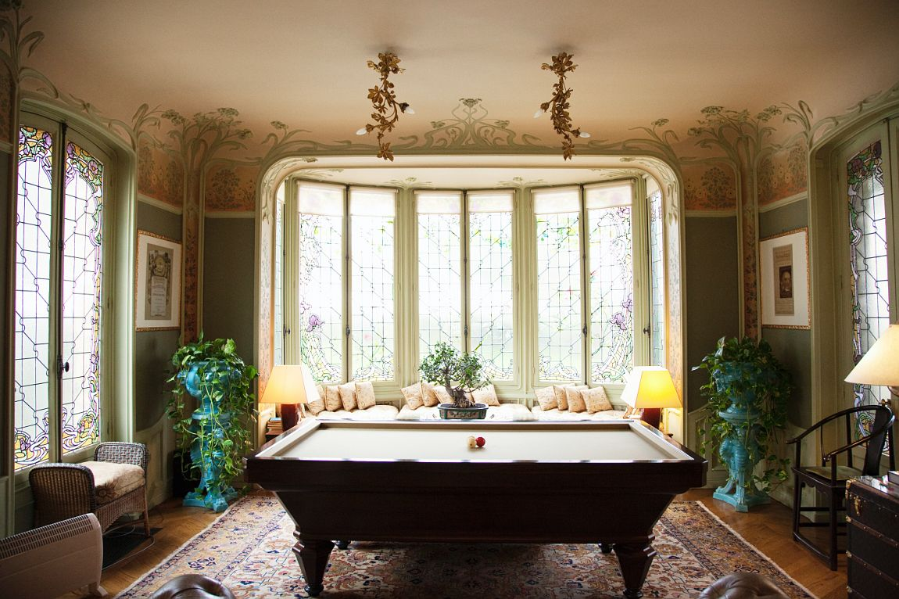
It’s Gorgeous Interior

Slide 5
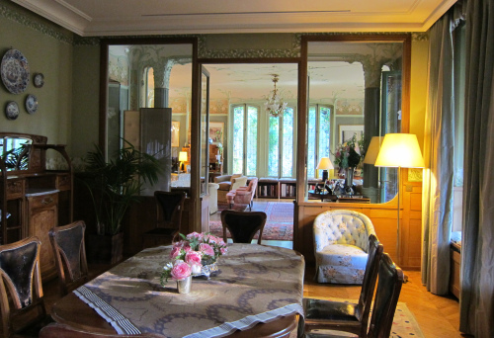
The Dining Room

Slide 6
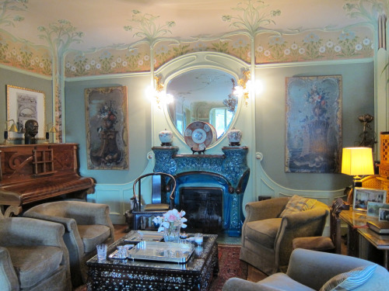
The seating area

Slide 7
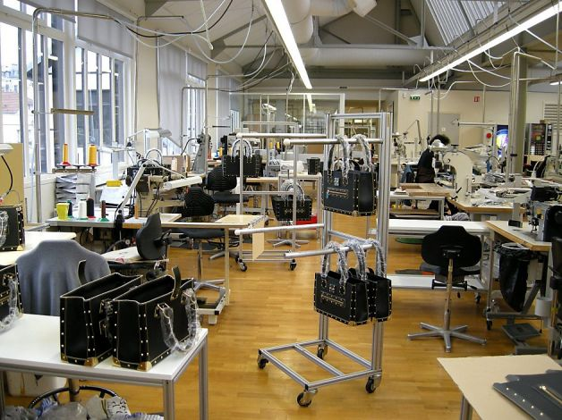
Inside the Louis Vuitton factory

Slide 8
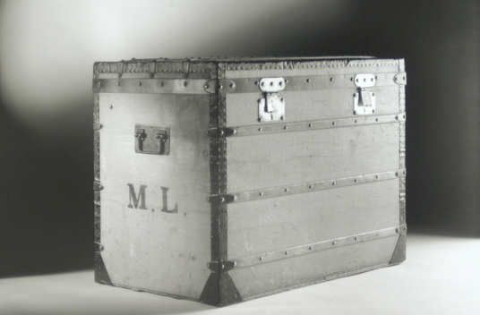
The Flat topped trunk (1858)

Slide 9
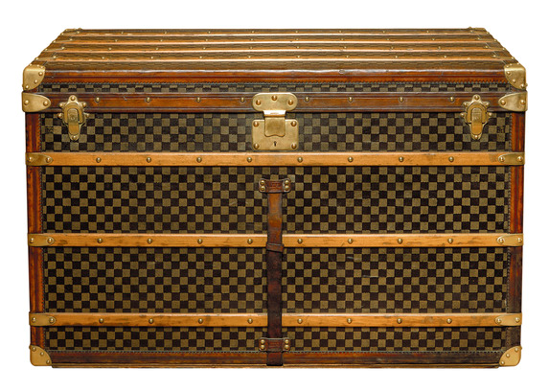
The checker board canvas (1888)

Slide 10
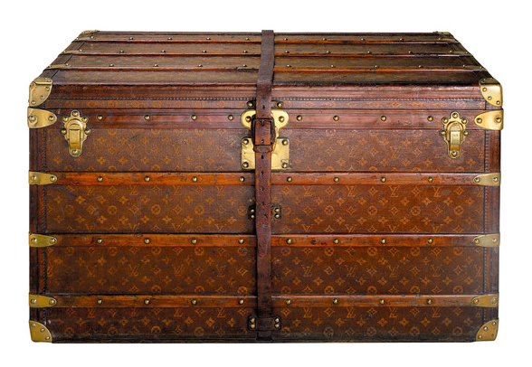
The monogram canvas (1896)

Slide 11
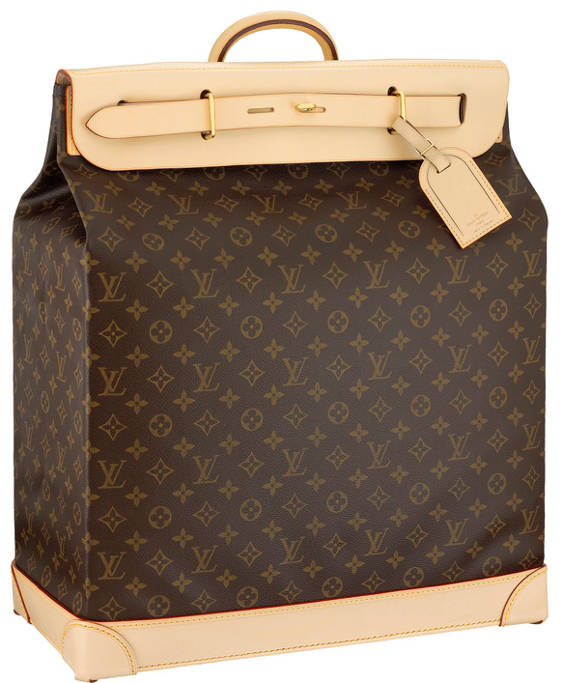
The steamer bag (1901)

Slide 12
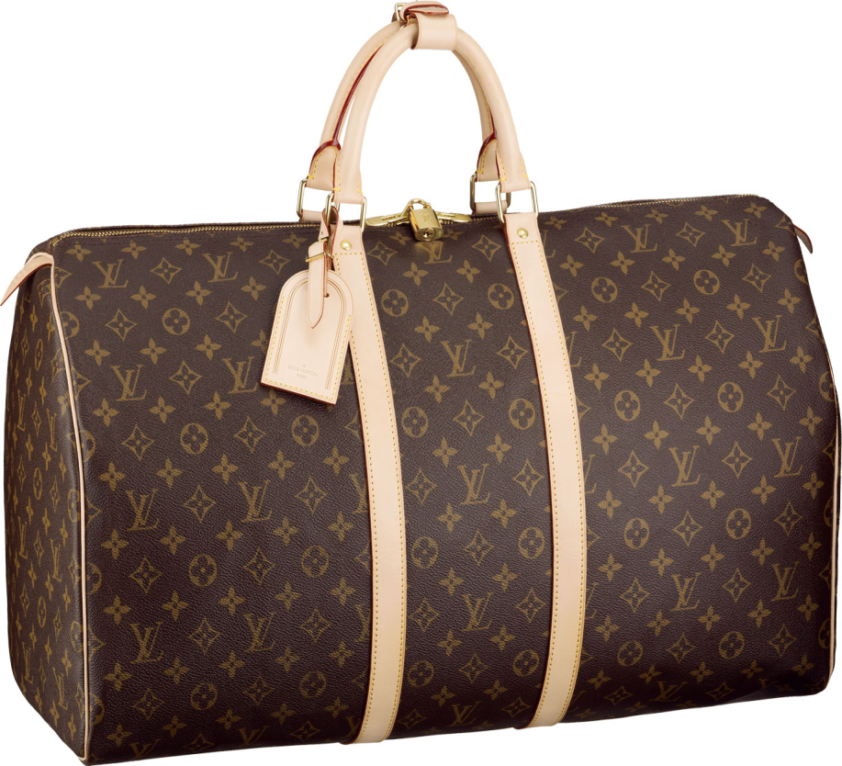
The keep all bag (1924)

Slide 13
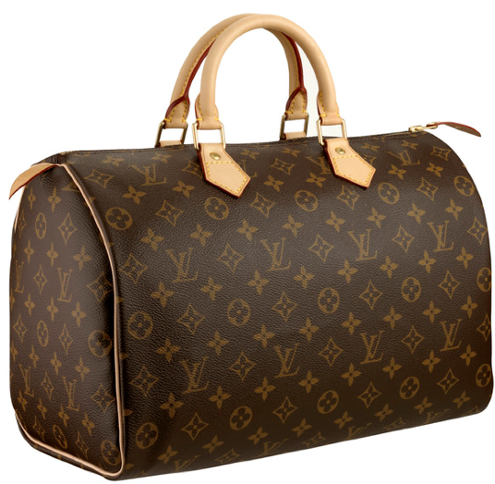
The classic speedy bag (1930)

Slide 14
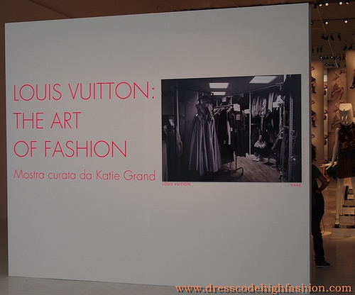
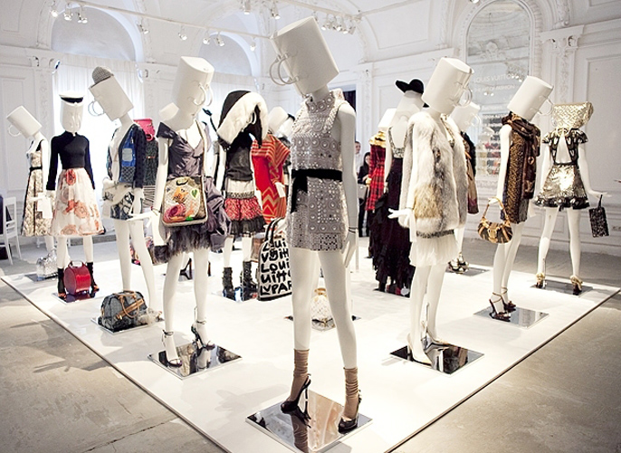
Louis Vuitton's fashion displayed in Milan art exhibit

Slide 15
Work cited
"Louis Vuitton." Contemporary Fashion. Gale, 1995. Gale Biography In Context. Web. 20 Nov. 2012.
”Louis Vuitton.” Encyclopedia of world Biography. Vol .28. Detroit: Gale, 2008. Gale Biography In Context. Web. 26 Nov. 2012.
http://upload.wikimedia.org/wikipedia/commons/thumb/0/0d/Portrait-Louis-Vuitton.jpg/220px-Portrait-Louis-Vuitton.jpg
http://kunkun.tripod.com/loius.gif
http://rbjello.files.wordpress.com/2012/09/img_2258.jpg?w=500&h=373
http://theselby.com/media/1_21_10_LVhouse15996.jpg
http://rbjello.files.wordpress.com/2012/09/img_1574.jpg?w=500&h=342
http://rbjello.files.wordpress.com/2012/09/img_1572.jpg?w=500&h=375
http://ww4.hdnux.com/photos/06/73/26/1815939/9/628x471.jpg
http://www.thebagforum.com/upload/eac3851d41ae3380d9a1f177d14e6ca7.png
http://www.thebagforum.com/upload/bd1e6b4532c34e57ff72dd7a1ccc2639.png
http://www.thebagforum.com/upload/668eca9fe7d0c4b54628005ed3ae63c6.png
http://cdn1.purseblog.com/images/louis-vuitton-steamer-case.jpg
http://www.allhandbagfashion.com/wp-content/uploads/2011/07/12/Louis-Vuitton-Womens-Keepall-55-travel-bag-1.jpg
http://s3.amazonaws.com/cmi-niche/assets/pictures/8766/content_pic03902.jpg?1304373416
http://farm7.static.flickr.com/6178/6189618486_ea4643d498.jpg
http://4.bp.blogspot.com/-fYXXGZAYDYQ/ToLz_7-UZNI/AAAAAAAAB-E/jNdyT5JjAzE/s1600/013_2687155_img9939.jpeg

